Slide 1
Strategic Partnership Eniac & Magist
Santhoshi, Vijayapriya, Xenia

Slide 2
Our key points
Magist as a partner ?
What are they buying?
For our high-end products
Customer’s shopping tendencies
Final insights
Deliveries
Are they fast enough?

Slide 3

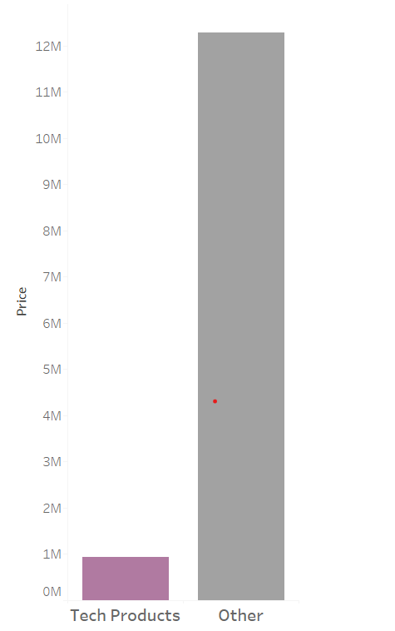
Only ≈ 10% of tech related products
90%
10 %

Slide 4
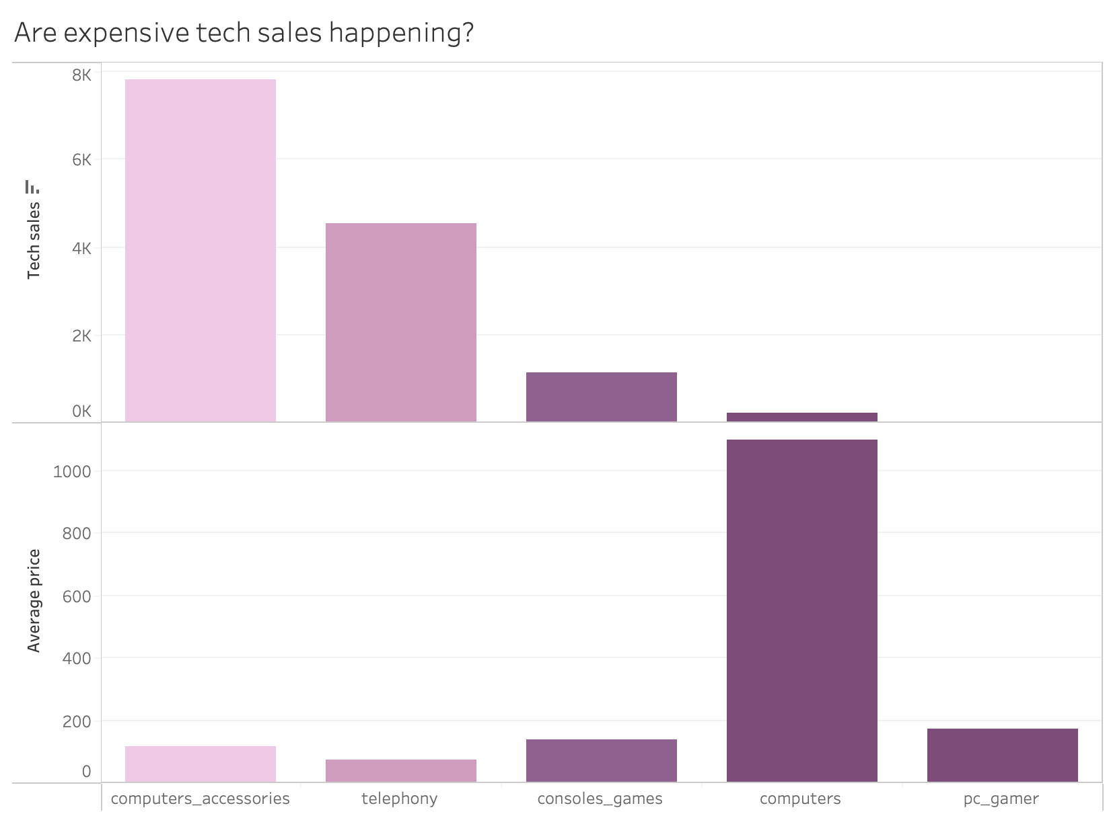
Magist’s customers are more attracted to cheaper products.
Computers (expensive) aren’t doing so well for e.g.

Slide 5
ONLY ≈40K
of Magist is tech - oriented revenue
WE MADE €14M LAST YEAR!

Slide 6
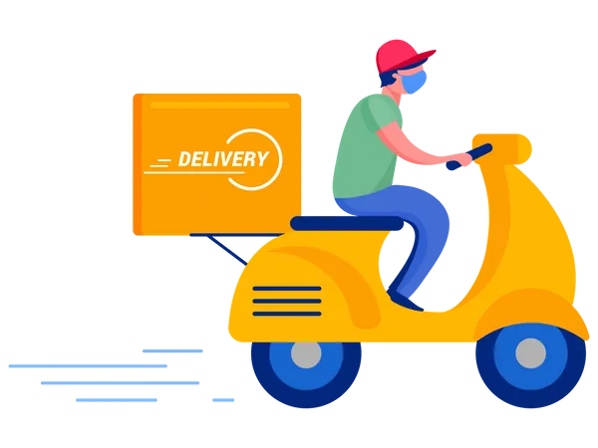
Delivery time
≈ 12.5 days
Compared to 16-17 days in Brazil
Around 90% of Magist’s deliveries reach their final destination.

Slide 7

Final insights from our analysis
Market alignment → not optimal
Visibility concerns for our products.
Revenue gap for tech.
Sales performance → low for high-end products.
Other retailers as suggestions;
Hotmart
Kentro Servicos Digitais LTDA

Slide 8

Thank you !

